Slide 1

E MED

Slide 2



TEAM MEMBERS
Syed Noor E Newaz
Afroza Sultana
MD Mehedi Hassan Rafi
011 181 305
011 181 085
011 182 096
Rakibul Islam
Md. Shafiqul Islam
011 181 002
011 181 170

Slide 3
SHORT DESCRIPTION
E-med will be the first startup company in Bangladesh, which is offering you different kinds of medical services on just one platform. We are focused on getting you the healthcare support & help you need so that you can enjoy your best health.
You can earn money via E-med, reuse it through buying medicines and other medical equipment. Not only for the user, we are offering different kinds of services for the medical companies and Doctors also. Our main target audience is general people, medical companies, and doctors. You can use this platform for various purposes which makes E-med completely unique.

Slide 4
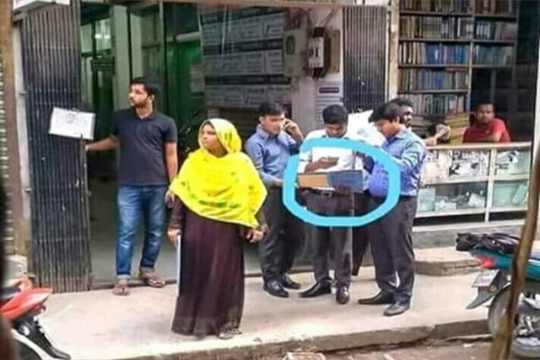
IDEA MOTIVATION
Had you ever faced any situation like this before?

Slide 5
IDEA MOTIVATION
Then, How would it be like if we didn't have to do this task physically?
The situation is a harassment situation for a patient actually. So, we decided to create a site where people can upload their prescriptions, when they upload that they will get some money from it. Which will encourage them to upload more prescriptions. As you know it’s all about money.
But here is a twist, this money is a virtual currency. They can’t cash out the money from the site. But they can use it to purchase any product from our site.

Slide 6
STRENGTH & WEAKNESS
STRENGTH:
We have some unique and trending features like earning money, virtual currency, buying prescriptions, online doctor consultations etc. Which makes E-med more stronger than any other competitor in the market. Also in the sense of business, we can do more profit through our services. At a time we are providing you different kinds of services and also we are making business.
WEAKNESS:
Our main weakness is live customer support and auto prescription plagiarism checking. Right now we are doing manually it but in future, we will upgrade it using AI image recognition.

Slide 7

Project Features

Slide 8
The Final Features
Upload Prescriptions and earn money.
Sale prescriptions to the medial pharmaceutical company.
Online medicine and medical equipment’s shopping.
Online doctor consultancy.
Earn money from the site and reuse it.
Search medicines .
Product reviews and feedbacks
Browsing products by category and Sub category.
Wishlist system.

Slide 9

Who made What ?

Slide 10
Syed Noor E Newaz
Upload Prescriptions and earn money
Product & Order Management
Product reviews and feedbacks

Slide 11
Wish List
Admin Panel
MD Mehedi Hassan Rafi
Online doctor consultancy
Search medicines
Afroza Sultana

Slide 12
Sale Prescription
Front End
Part Of Admin
Md. Shafiqul Islam
Shopping Cart
Rakibul Islam

Slide 13
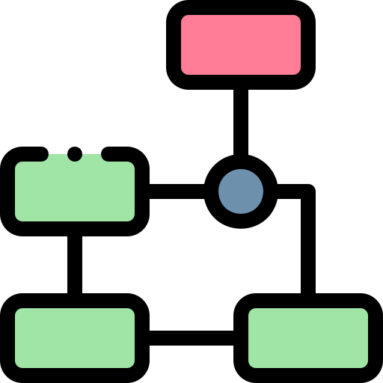
SWOT ANALYSES

Slide 14

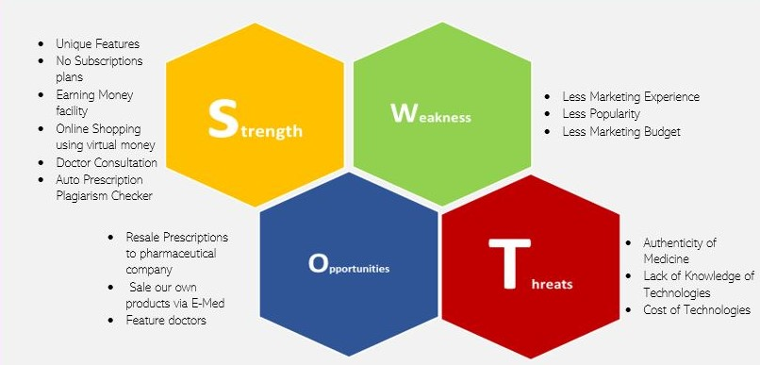

Slide 15
USE CASE DIAGRAM

Slide 16
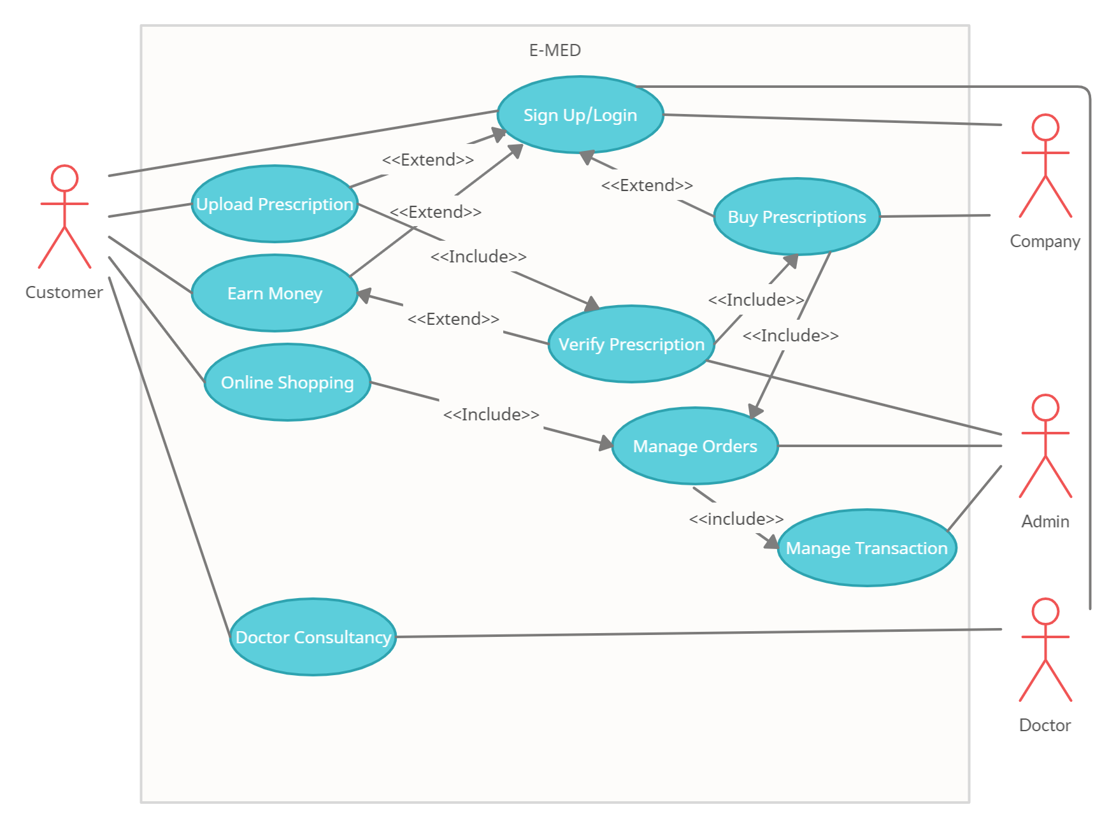

Slide 17
USE CASE DESCRIPTION
Use Case 1:
Upload Prescriptions
Primary Actor:
Customer or user
Stakeholders And Interests:
User or Customer: Wants to upload prescriptions smoothly without any error.
Admin: Verify prescriptions.

Slide 18
USE CASE DESCRIPTION
Pre Condition:
Users must have to register on the site.
Should be a authorized user.
Post Conditions:
Prescriptions will remain in the database if user logs out.
Users can see the status of verification of their prescriptions.
Changes are made in the database.

Slide 19
USE CASE DESCRIPTION
Main Success Scenario:
User logs into the system using the username and password.
Users uploads the prescription to the system.
Admin verifies prescriptions.
System records the entry of user.
After getting approved, users will get money.

Slide 20
USE CASE DESCRIPTION
Alternate Scenario:
At any time system can be down.
Solutions: System is recovered to prior state.
User may not find the option to upload prescriptions.
Solutions: Highlight the option more than twice in the system.
System may have bugs or system errors.
Solutions: Contact the admin and let us know.

Slide 21
USE CASE DESCRIPTION
Issues:
If username and password is not correct, error message will be shown.
If the user doesn’t provide proper information, an error will be shown.
Without filling all the required fields, users can’t upload prescriptions.

Slide 22
DATA FLOW DIAGRAM

Slide 23
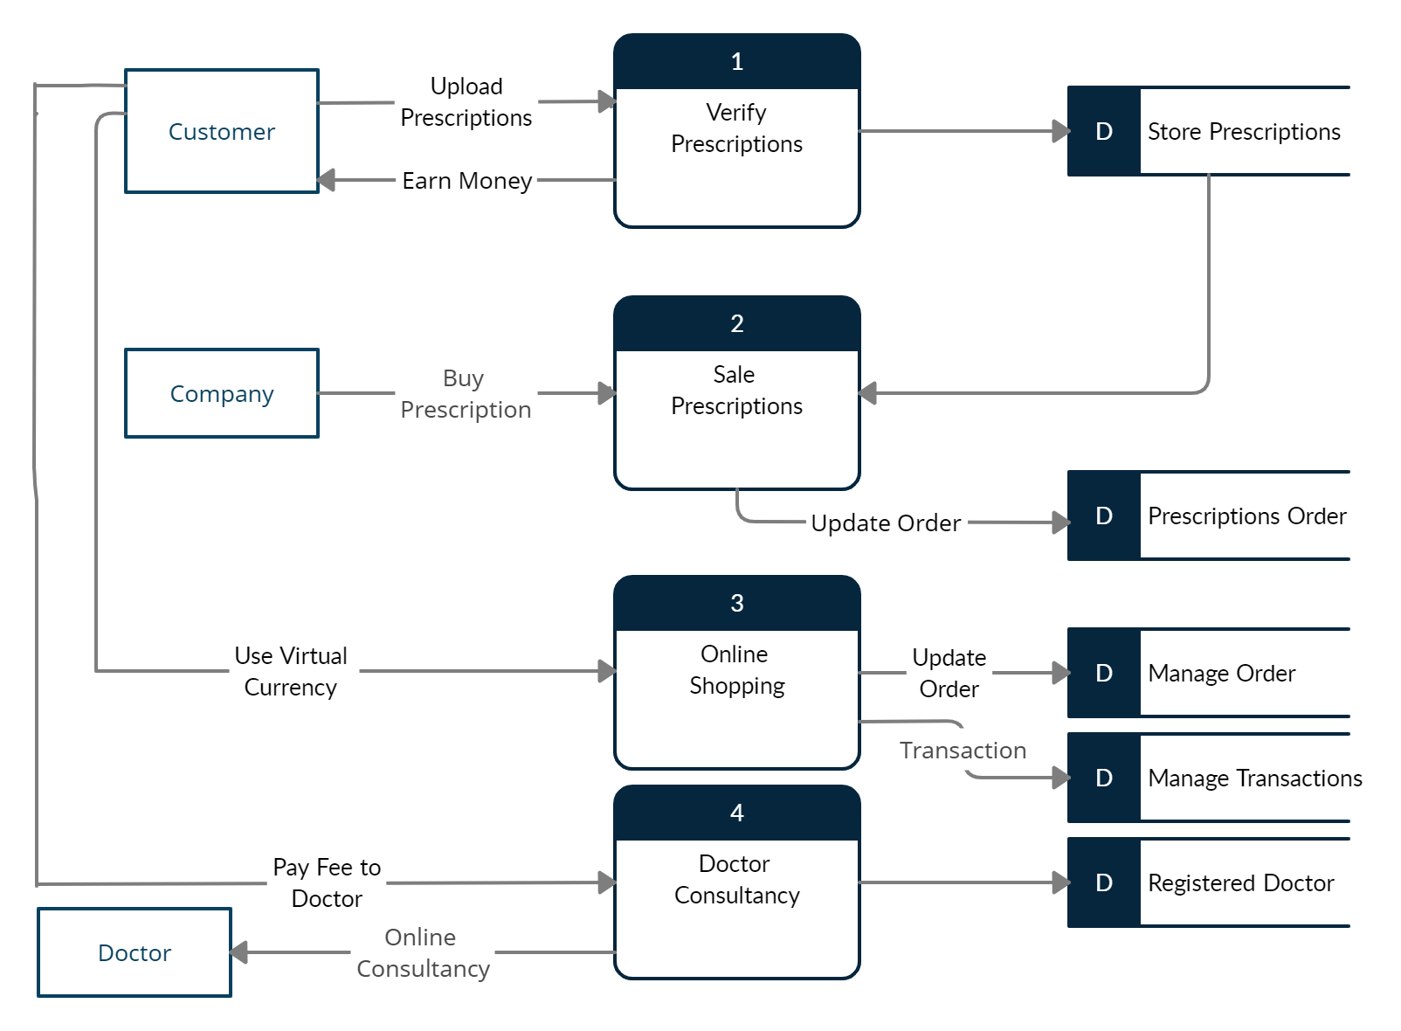

Slide 24
CLASS DIAGRAM

Slide 25
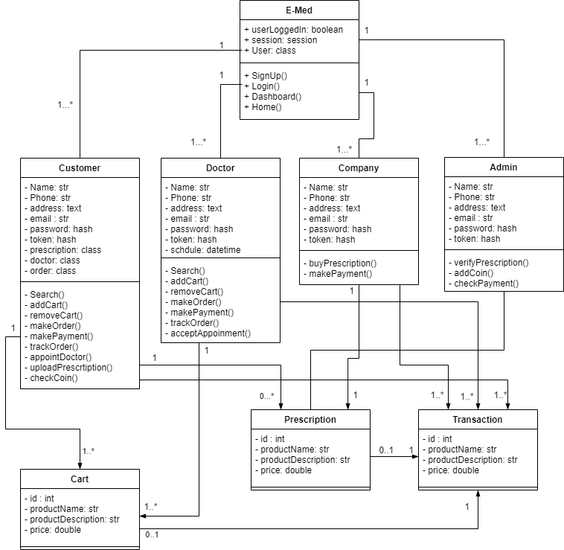

Slide 26

Project Main UI

Slide 27

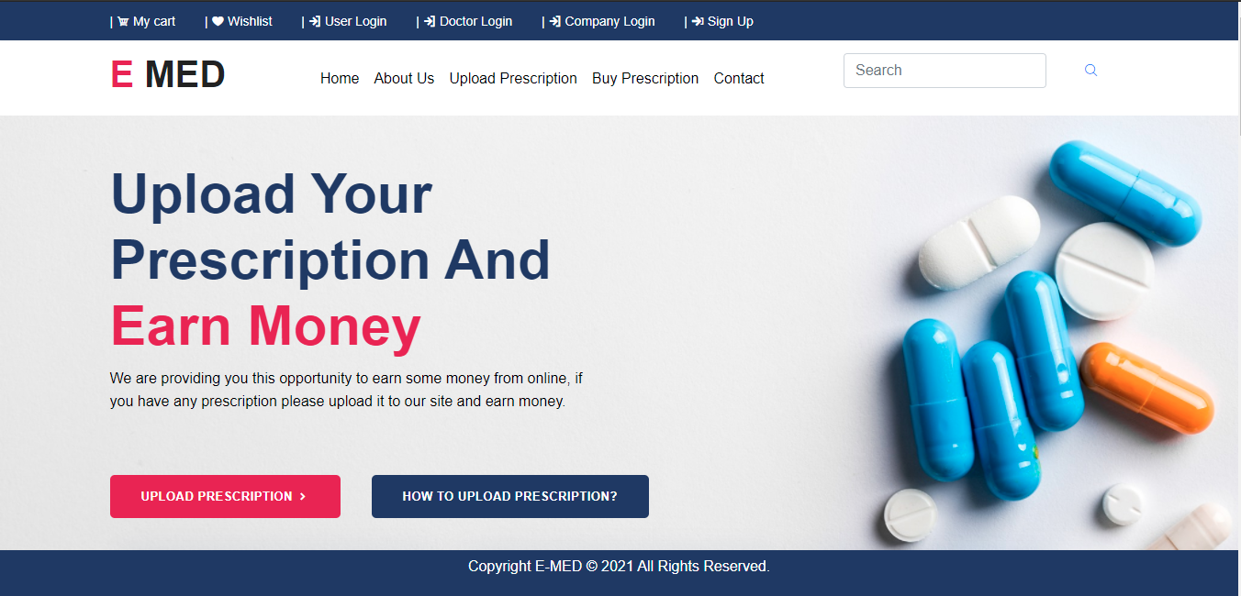
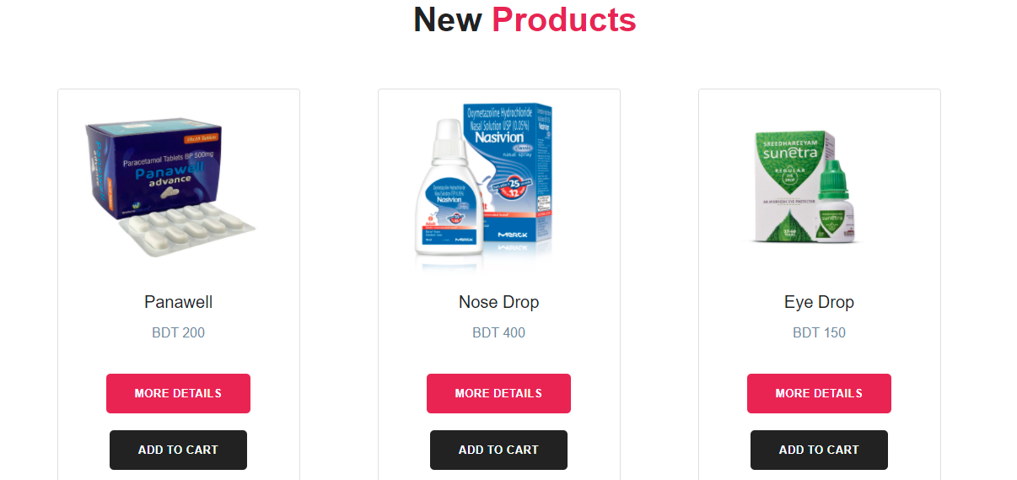
Home page
Products
Notes:
Step 1 : Go to home page. Step 2: Scroll down and find some products

Slide 28
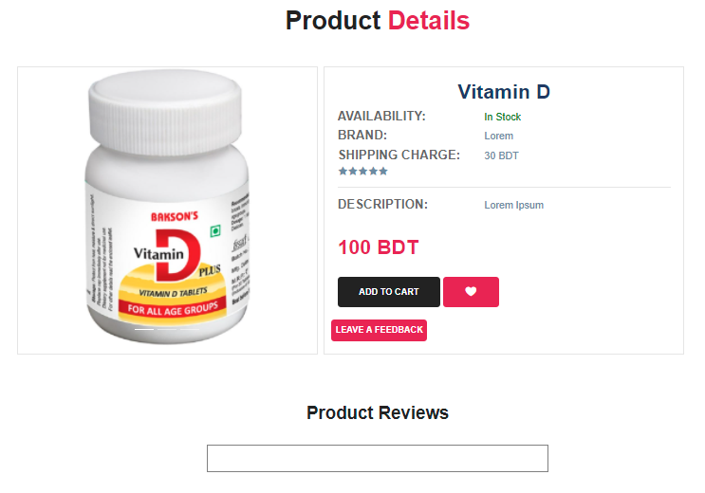
Single Product page
Notes:
Step 3 : By clicking any product it takes user into a product page like this Then pres add to cart for adding into cart, or press favorite button for storing into wishlist

Slide 29
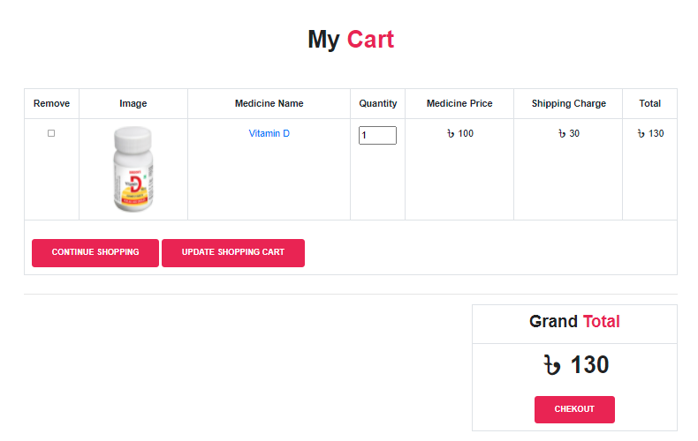
Cart View

Slide 30
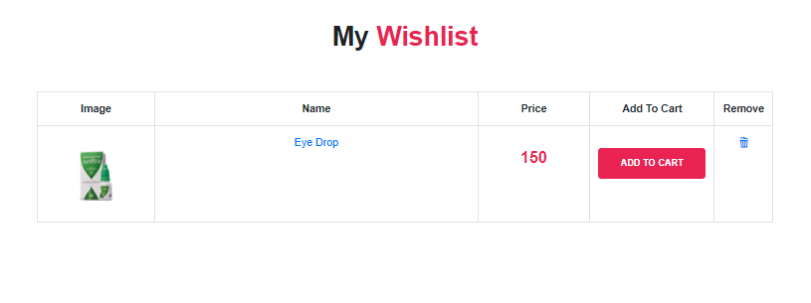
Wish list View

Slide 31
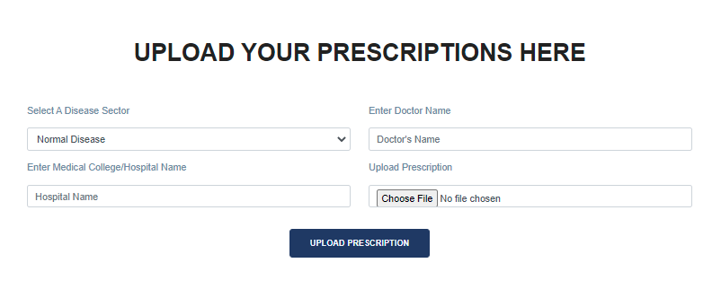
Upload Prescription

Slide 32
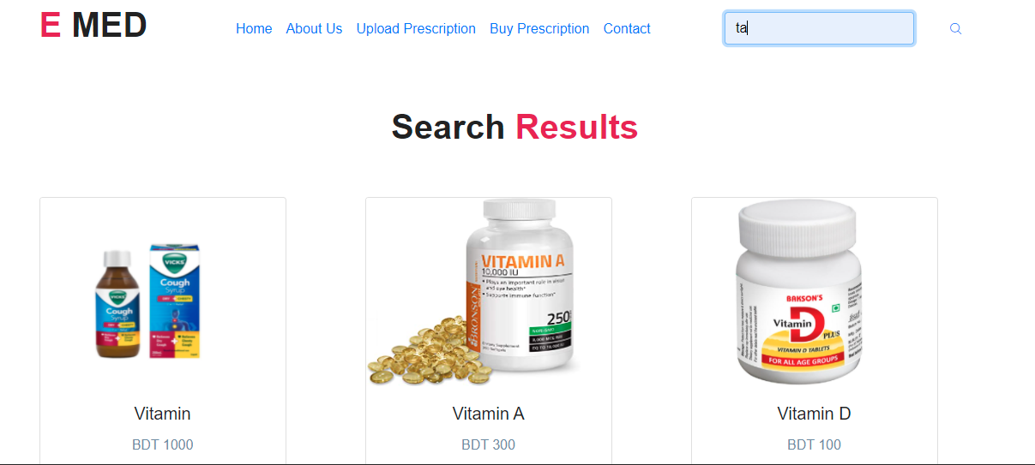
Search result

Slide 33
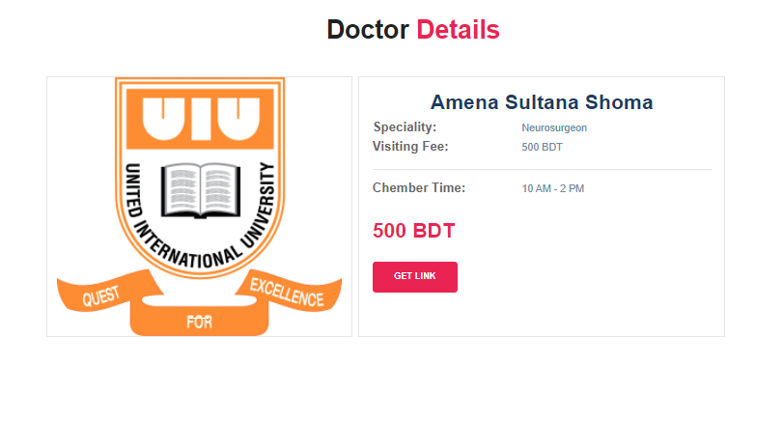
Doctor Page ( User End)

Slide 34
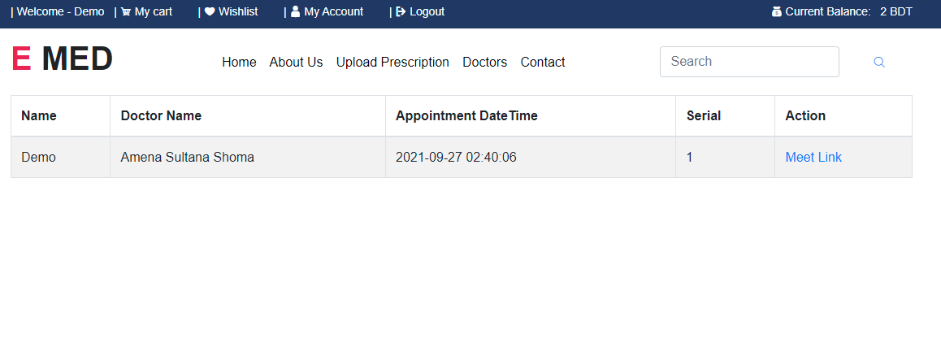
Doctor Appointment and Meet

Slide 35
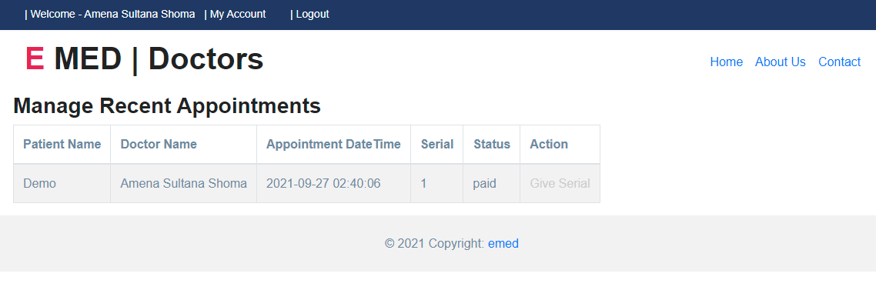
Doctor Homepage

Slide 36
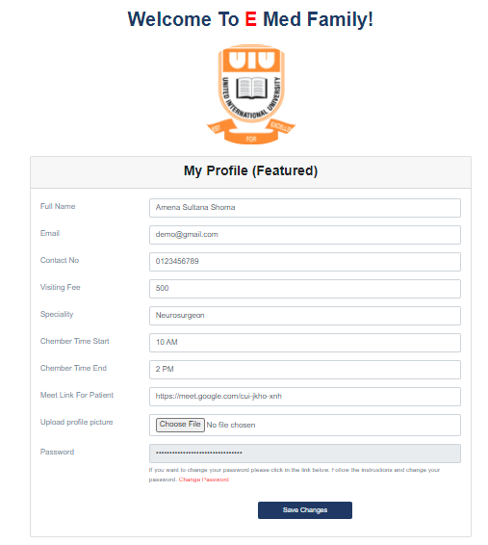
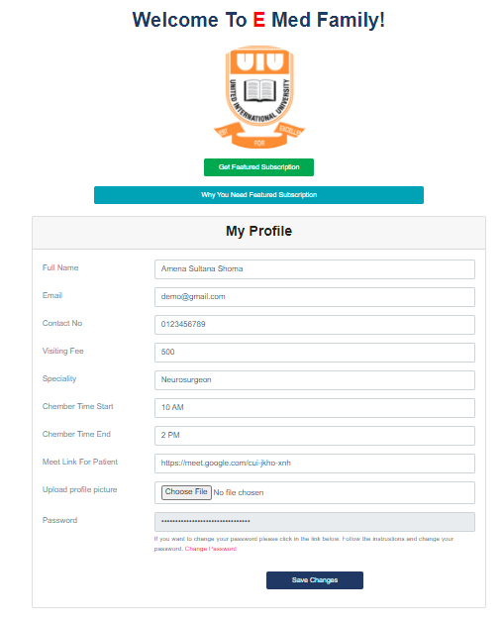
Doctor Profile

Slide 37
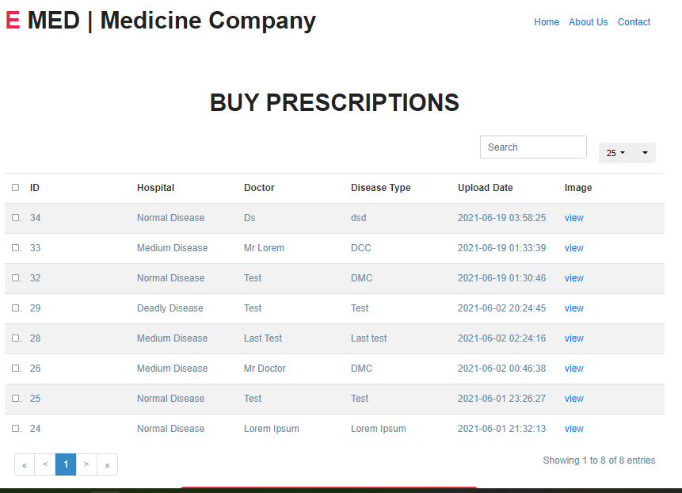
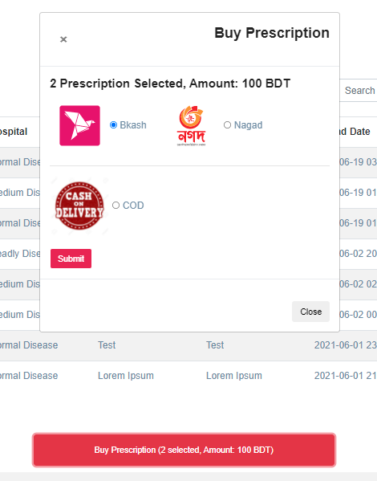
Company Homepage

Slide 38
Technologies

Slide 39






Technology:
Lets check out the list of technologies we will use to develop the site.
Front End
HTML 5
CSS 3
Bootstrap 4
jQuery
JavaScript

Slide 40


Technology:
Lets check out the list of technologies we will use to develop the site.
Back End
PHP 7.4
MySQL (database)

Slide 41



Technology:
Lets check out the list of technologies we will use to develop the site.
Applications
XAMPP
Visual Studio
Visual Paradigm

Slide 42

Future Improvements
Prescription Recognition Using AI.
Advanced Prescription Plagiarism Check.
Feature new medicines of different companies.
Comparison between medicines of different companies and composition.
Suggestion of Alternative medicine.

Slide 43
Thank You !
Any questions?

